Slide 1
Time series Analysis of Hospitality Employees
By:-Aditya Jadhav

Slide 2
Aim
To develop an accurate and reliable forecasting model for predicting the future trends in the number of hospitality employees based on historical time series data.
Objective
To develop a model to forecast the Hospitality Employees
by applying time series analysis techniques and methods

Slide 3
Overview of Dataset
The dataset name is HospitalityEmployees.csv
consists of 2 columns which are Employees, Date.
The size of the dataset is (348, 2) which is 348 rows and 2 columns.

Slide 4
METHODOLOGY
The methodology revolves around a sequence of steps to be followed in
order to reach to our target i.e. to make forecast for Employees from given dataset
Data Collection.
Data Preparation.
Data Preprocessing.
EDA.
Time Series Analysis.
Model Building.
Forecasting Result.

Slide 5
ADF Test for Stationarity
ADF Statistic Values
ADF Statistic | 0.901284
P-value | 0.993107
Critical values:
1% | -3.450
5% | -2.870
10% | -2.571

Slide 6
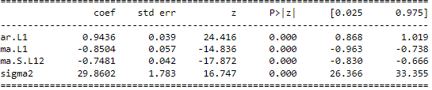
SARIMA Model

Slide 7
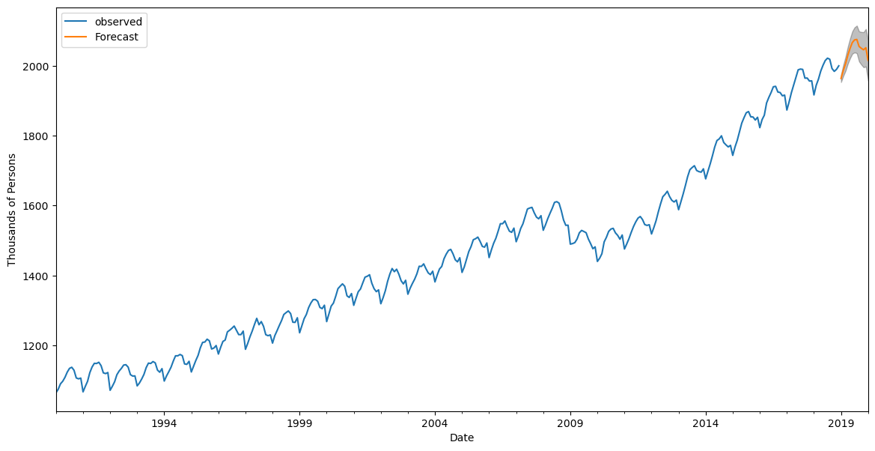
Forecasted Plot

Slide 8
CONCLUSION
The SARIMA model demonstrated effectiveness in forecasting hospitality employees based on historical time series data.
Forecasting for the next one years aligns with the observed seasonal and trend patterns, providing reliable predictive increases linearly over times.

Slide 9
-THANK YOU-

